Slide 1

Fast and Precise Sparse Value Flow Analysis for Million Lines of Code
Qingkai Shi¹, Xiao Xiao², Rongxin Wu¹, Jinguo Zhou²,
Gang Fan¹, and Charles Zhang¹
¹The Hong Kong University of Science and Technology
²Sourcebrella Inc.
Notes:
Good afternoon. Welcome to my presentation. My name is Qingkai, a PhD student from HK. I am very happy here to introduce our recent work on static bug finding: pinpoint, fast and precise sparse value flow analysis for MLOC.
This is a joint work by the HKUST and sourcebrella, a technology company from China.

Slide 2


Source-Sink Problem
Double Free
Taint Issues
Use After Free
Invalid Use of Memory
XSS
Leak of Sensitive Data
Stack Address Escape
CSRF
Use of Uninitialized Variable
SQL Injection
Null Pointer Dereference
Command Injection
Notes:
In 2014, the most glamorous security bug was discovered in OpenSSL, affecting millions of websites are affected including Google, Yahoo, Amazon, and our own CSE department
Like many common issues including …, the heartbleed bug is actully a source-sink problem, a malicious input from an attacker, which is the source, then flows to an sensitive instruction, which is the sink, causing the problem.

Slide 3
Heart Still Bleeding
Big Size
1/2 MLoC, 92 directories, 3500 functions
Very Fast (5-10 Hours)
Scale to millions of lines of code
High Complexity
7 files, over 13,000 lines, 44 functions with intensive pointer operations
High Recall
Understand memory operations and deep calling contexts.
Needle in a Haystack
memcpy: 647 places in over 100 files
Good Precision (<30% FPs)
Understand complex path conditions
Notes:
Unfortunately, we observe that it is still difficult for existing bug detectors to find bugs like heartbleed.
Heartbleed is in a typical industrial-sized project with half million LoC, 92 directories and over 3500 functions
The bug itself is very complex as it spans across 7 files over 13,000 lines and 44 functions with intensive pointer operations
The function that causes the issue is used at 647 places in over 100 files. Detecting it is just like to find the needle in a hystack
Therefore, to detect bugs like heartbleed, a bug detector must …

Slide 4
“Dense” Program Analysis
Track value flows on the control flow graph.
Many classic approaches: IFDS/IDE, Saturn, Calysto, Clang, Infer, etc.
Performance issues: 6-11 hours for checking null pointer dereference for programs of 680KLoC.
I = …
control flow
…
…
J = I
[Reps et al 1995; Babic et al 2008; Xie et al 2005]
Notes:
Existing approaches to detecting source-sink problems can be put into two categories: dense analysis and sparse analysis.
dense analysis, including IFDS framework, Saturn, Calysto, tracks value flows based on the control flow graph,analyzing the program statement by statement
Thus, for source-sink problems, they will analyze a lot of unrelated statements,
As the example shown on the right, the red statements are unrelated to the value flow from I to J.
But if we follow the dense approach, we have to take them into consideration, leading to many performance issues.
According to a recent report, a dense approach may take 6-11 hours for only checking one source-sink property

Slide 5
“Sparse” Program Analysis
Track value flows sparsely via data dependence is cheap.
Many classic approaches: Fastcheck, Saber, etc.
I = …
control flow
…
data dep.
…
J = I
[Cherem et al 2007; Livshits et al 2003; Oh et al 2012; Sui et al 2016, …]
Notes:
On the other side, Recent work has shown that sparse analysis can be much cheaper because they track value flows sparsely via data/dep to skip irrelevant statements.
In the example, along with the data dependence, the value of I can directly flows to J, skipping the irrelevant red statements.

Slide 6
“Sparse” Program Analysis
Track value flows sparsely via data dependence is cheap.
Many classic approaches: Fastcheck, Saber, etc.
“Pointer Trap”: Existing sparse analysis cannot escape from the pointer trap.
*P = I
control flow
…
P alias Q?
…
J =*Q
[Cherem et al 2007; Livshits et al 2003; Oh et al 2012; Sui et al 2016, …]
Notes:
However, because modern software is filled with pointer operations, building data dependence has to rely on a pre-computed pointer analysis.
As the similar example shown on the right, to determine the value flow between I and J, we need to query a pointer analysis whether P and Q are aliases.
So, although the sparseness allows for more efficient analyses in general,
we may have to perform a very expensive pointer anlysis to build the data dep, which we refered to as the “pointer trap”
Unfortunately, to the best of our knowledge, there is no existing sparse analysis that can escape from the pointer trap.

Slide 7
The “Pointer Trap”
The conventional “layered” design
Pointer Analysis
Data Dependence Analysis
Value-Flow Analysis
Precise
Precise
Precise
Bad Performance
Good Performance
Imprecise
Imprecise
Imprecise
Notes:
To explain the pointer trap, let’s review the design of conventional sparse value-flow analysis, which we refer to as a “layered” design, because it does PTA/DDA/VFA in order
we observe that there is a precision-performance dilemma in the design,

Slide 8
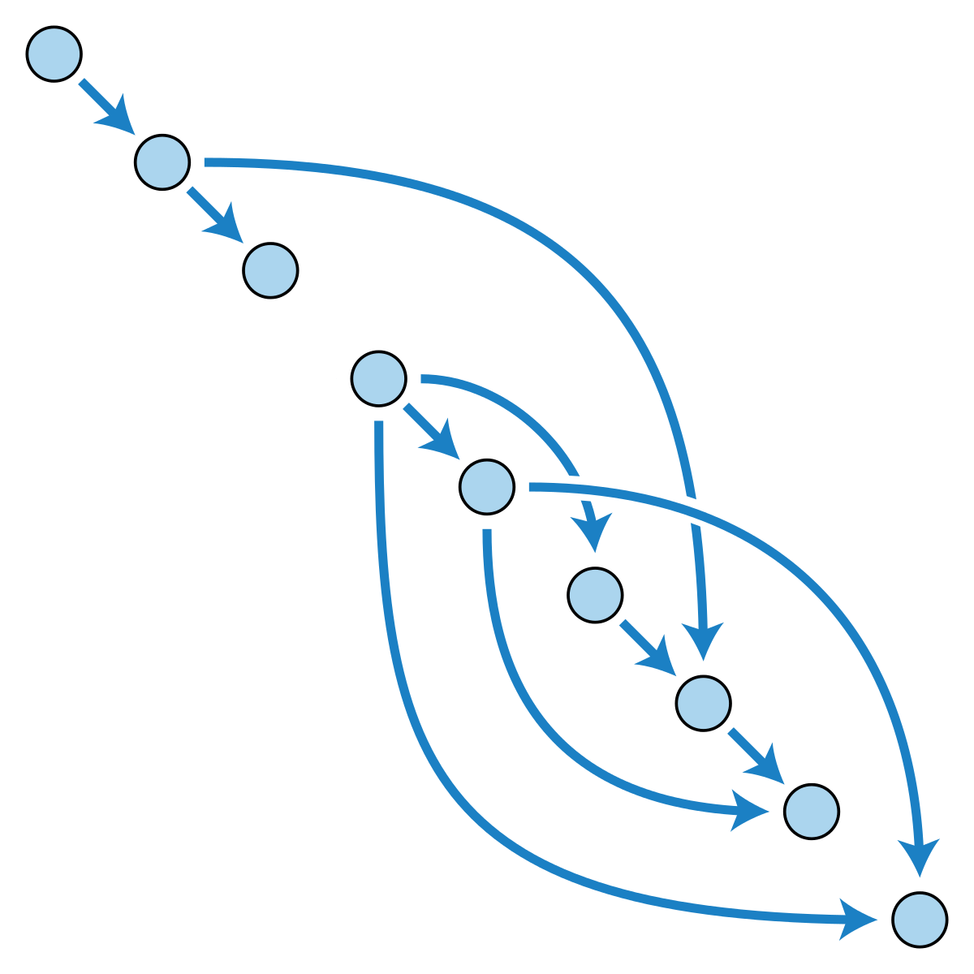
Trade Precision for Scalability
Use Imprecise Pointer Analysis
Flow-insensitive
Context-insensitive
Unification-based
Compromise Path-sensitivity
Only solve “easy” path conditions
Do not track branch correlations
False Edges
[Cherem et al 2007; Livshits et al 2003; Oh et al 2012; Sui et al 2016, …]
Notes:
To achieve scalability, existing approaches usually only adopt .. and choose to
In result, there will be many false edges … which will lead to many false positives

Slide 9
Our Main Contribution
Abandon the “Layered” Design
Escape from the “Pointer Trap”
Achieve Efficiency and Precision Simultaneously
Notes:
In this work, our main contribution is to resolve the pointer trap, thus getting an approach called pinpoint that is both fast and precise.

Slide 10
How Fast and How Precise?

Slide 11

Performance
2
Relatively Fast
1.5 hours for MySQL, a 2 MLoC project, full path-sensitivity and 6-levels of calls
High Recall
Detected >100 serious bugs in ~30 extensively checked open source projects.
Some bugs have been hidden for >10 years
Build on LLVM
Checking Bugs in C/C++ Programs
Good Precision
15% ~ 30% false positives
Notes:
In one word, the performance of pinpoint is aligned with the common industrial requirement: finding as many as vulnerabilities in MLOC, using 5-10 hours and with less than 30% false positives.
check different bugs/positives currently how many checkers. precision explain -> reported in paper
As a general framework, we have developed checkers for different kinds of source-sink problems, So far, we have more than 100 serious bugs in about 30 open source projects

Slide 12


Benchmarks
2
mcf
bzip2
gzip
parser
vpr
crafty
twolf
eon
gap
vortex
perlbmk
gcc
webassembly
darknet
html5-parser
tmux
libssh
goaccess
shadowsocks
swoole
libuv
transmission
git
vim
wrk
libicu
php
ffmpeg
mysql
firefox
Notes:
The benchmarks we choose to evaluate pinpoint include 12 SPEC benchmark programs and 18 github trending projects.

Slide 13
Benchmarks
3
> 1,000KLoC
6
< 1,000KLoC
Project | LoC
firefox | 8M
mysql | 2M
ffmpeg | 1M
21
< 100KLoC
Notes:
The sizes of these programs range from a few thousand LoC to close to 8million
The three largest programs are firefox, a commonly used browser; mysql, the most popular open-source relational DB, and ffmpeg, an audio and video processing software.

Slide 14
Evaluation Setup
Single commodity 16-way server
Comparison to both academic and industrial tools
SVF / Clang Static Analyzer / Facebook Infer
High bar to quantify bug finding capabilities
Count as a true bug only if a report is confirmed by the developers.
Notes:
In the evaluation, we not only compare to
We want to highlight that we set a high bar for true positives, that is,

Slide 15
MySQL #87203: Use After Free in MySQL
1
Refuse to confirm
You can do the free operations three times in a row.
One of the four use after free in MySQL
A bug in an 1,000 LoC function
36 functions/11 compilation units
2
Difficult to confirm
We do a lot of analysis. … This remains “Not a Bug”.
3
Confirm
This bug is verified by dynamic methods (debugger).
Notes:
Pinpoint can detect very complex bugs. As an example, this is one of the 4 UAFs we detect in mysql, which occurs in a 1KLoC Function.
When we just report it to the developers, they cannot believe and tell us, they have done some magic operations and we can do the free operations three times in a row without any risks.
After some discussion, they start to do some analysis and still cannot confirm the bug.
Finally, with the help of some debugging tools, they then confirm the complex bug
so complex that mannual debugging cannot make it. needs a heavy debugger

Slide 16





ICU #13301: Double Free in ICU
It had been in the code for more than
10 years.
Affected hundreds of organizations.
Assigned CVE-201714952
Notes:
Pinpoint can detect bugs with high impacts.
This is a double free bug in ICU, which has been in the code for more than 10 years, although ICU is extensively checked by mature bug detection tools.
This bug affects hundreds of organizations and projects, and is assigned with a CVE ID.
add more bug information, zoom out the figures

Slide 17
Scalability
2 MLoC
1.5 Hours
8 MLoC
4 Hours
Memory
Time
Notes:
To the performance of checking bugs, we observe that Pinpoint’s time and memory cost grow almost linearly in practice, as we can see that the R2 of the regression curves is larger than 0.92.
For mysql, a 2MLoC project, pinpoint takes 1.5 hours to finish.
For Firefox, a 8MLoC project, pinpoint takes about 4 hours to finish.
Thus, Pinpoint is very scalable
explain R^2

Slide 18
Precision
True Positives
False Positives
Pinpoint
# FP | 2
# TP | 12
Time | < 5 hr
SVF
# FP | > 1K
# TP | ~ 0
Time | > 12 hr
Clang
# FP | 24
# TP | 2
Time | < 1 hr
Infer
# FP | 35
# TP | 0
Time | < 1 hr
Notes:
In terms of precision, pinpoint detected 12 real UAFs with 2 false positives.
Because the imprecision of pointer analysis, SVF reports thousands of false warnings and takes more than 12 hours to finish.
We also compare pinpoint with two open source bug detector, clang and infer. Both of them can finish checking each project in one hour, but have high false positives and false negatives.
Here, because we cannot flood all bug reports to the software developers, we actually first manually check the bug reports and reported suspicious reports to the developers.

Slide 19
The Key Ideas

Slide 20
Limitation of the “Layered” Design
Pointer Analysis
Data Dependence Analysis
Value-Flow Analysis
A lot of data dependence is irrelevant to bugs.
Contexts
Paths
Pointers
Notes:
Our key observation is that following the conventional layered design, we actually compute a lot of data dep that is irrelevant to any bugs we are going to check.
Therefore, we compute a lot of redundant calling context info/ path info, as well as unnecessary pointer relations

Slide 21
Blend the Layers
Build function-level data dependence graphs to memorize
Non-local values as function parameters and return values
Complex path conditions
Stitch function-level graphs on-demand to collect
Inter-procedural pointer information
Context and path information
Solve the collected information using Z3
D
Notes:
In order to avoid the computation redundancy, our solution is to blend the layers.
In stead of performing the pointer analysis independently, we
spread the computation of pointer info across the whole process, so that the expensive info is only computed for bugs to detect
First, we only build function-level DDG, which memorizes non-local pointers as … so that we avoid maintaining calling contexts
We do not solve complex path conditions, but encode with the DD. In this way, we avoid solving path conditions exhaustively for each path.
In the second step, to avoid computing inter-procedural info exhaustively, the function-level graphs are stitched together only when necessary. When tracking values, we collect the interprocedural pointer information as well as the context and path information.
Finally, the collected information is input to a constraint solver to determine whether there is a bug.

Slide 22
Step 1: Build Function Graph – Purify the Callee
int test(int* p, int X) {
int v = X; // X = *p
if (v < 0 || v >100000) {
*p = 10;
}
Y = *p; return Y;
}
void test (int* p) {
int v = *p;
if (v < 0 || v >100000) {
*p = 10;
}
}
Notes:
Let us use a concrete example to demo our approach.
To build function-level graph,
the first step is to transform each function into its pure function counterpart.

Slide 23
Step 1: Build Function Graph for the Callee
int test (int* p, int X) {
int v = X; // X = *p
if (v < 0 || v >100000) {
*p = 10;
}
Y = *p; return Y;
}
Y
p
v∈[0,100000]
v<0 || v>100000
v
10
X
*p = 10
Notes:
Let us use a concrete example to demo our approach.
To build function-level graph,
the first step is to transform each function into its pure function counterpart.

Slide 24
Step 1: Build Function Graph – Purify the Caller
3
void main () {
int *q = alloc(32);
scanf(“%d\n”, q);
int A = *q;
B = test(q, A);
*q = B
memcpy(…, ..., *q);
}
void main () {
int *q = alloc(32);
scanf(“%d\n”, q);
test(q);
memcpy(…, ..., *q);
}
Notes:
To reflect the change of the function signature, we also insert an aux A to represent the value in the memory before the function call.
an aux B to represent the value after the function call
rename the name “check” ->
Note that the caller function accepts a user input and uses the input as an argument in the memcpy function. as we know if the user input is too big, then there will be BOF bug. Thus, we need to track the value from the user input.

Slide 25
Step 1: Build Function Graph for the Caller
3
void main () {
int *q = alloc(32);
scanf(“%d\n”, q);
int A = *q;
B = test(q, A);
*q = B
memcpy(…, ..., *q);
}
memcpy(…, *q)
q
A
B
Notes:
To reflect the change of the function signature, we also insert an aux A to represent the value in the memory before the function call.
an aux B to represent the value after the function call
rename the name “check” ->
Note that the caller function accepts a user input and uses the input as an argument in the memcpy function. as we know if the user input is too big, then there will be BOF bug. Thus, we need to track the value from the user input.

Slide 26
Source-Sink Problem in the Example
3
void main () {
int *q = alloc(32);
scanf(“%d\n”, q);
int A = *q;
B = test(q, A);
*q = B
memcpy(…, ..., *q);
}
Get a user-input integer, stored in *q
A is the user-input integer
source
sink
The user input may cause buffer overflow
Notes:
To reflect the change of the function signature, we also insert an aux A to represent the value in the memory before the function call.
an aux B to represent the value after the function call
rename the name “check” ->
Note that the caller function accepts a user input and uses the input as an argument in the memcpy function. as we know if the user input is too big, then there will be BOF bug. Thus, we need to track the value from the user input.

Slide 27
Step 2: On-Demand Slicing
sink
void main () {
int *q = alloc(32);
scanf(“%d\n”, q);
int A = *q;
B = test(q, A);
*q = B
memcpy(…, ..., *q);
}
memcpy(…, *q)
q
source
A
B
no need
to build!
int test (int* p, int X) {
int v = X; // X = *p
if (v < 0 || v >100000) {
*p = 10;
}
Y = *p; return Y;
}
Y
p
v
10
X
*p = 10
Notes:
To determine if the user input will cause a bof at the memcpy function, we track value flows from A, the user input.
When tracking value flows, the local DDG can be stitched together by connecting formal/… They are stitched only when necessary.
For example, when tracking value flows from X, we know it will flow to b and Y. Then we can connect Y -> B and continue to track value flows.
higlight what is source/sink

Slide 28
A Holistic Design
Spread and blend the computation of pointer info across the whole bug finding stages.
Compute precise and expensive info only for value flows related to vulnerabilities.
NO independent pointer analysis. We need to dodge the “Pointer Trap”.

Slide 29
Future Work
Reduce memory cost
Model more libraries to reduce false positives
Resolve function pointers

Slide 30

THANKS !
Online Demo & Community Edition
Notes:
You can scan the QR code to try the online demo and request a community edition of pinpoint. Thanks again for your attention.
In the community edition, we provide some commonly used checkers, as well as beautiful GUIs for you to run pinpoint and review bug reports.
ad sourcebrella/pinpoint

Slide 31
Blend the Layers: A Holistic Design
Blend inter-procedural pointer analysis with the value-flow analysis!
Pointer Analysis
Data Dependence Analysis
Value-Flow Analysis
D
Notes:
According to the observation, we re-design the SVFA, and get a holistic design paradigm, in which the pointer analysis is never an independent module that provides query interface for the DDA.
Instead, the computation of pointer information is spread across the whole process, thus we call it a holistic design.
In our design, we first only do lightweight pointer analysis that is sufficient for building local data dependence.
When searching paths on the DDG, we then can on-demandly compute some alias information like A is an alias of D, as there is a path from A to D.

Slide 32
Imprecise Pointer Analysis for Memory Leak Detection
void main () {
int *a = malloc(32);
…
if (...)
free (...)
else
...
free (...)
}
a
…
…
free(..)
free(..)
Imprecision => False Negatives

Slide 33
Use-After-Free Detection
void main () {
int *a = malloc(32);
int *b = a;
free(a);
*b = 1; // use-after-free
}
a
source
b
free(a)
sink
*b = 1

